Slide 1
Please make your presentation on this slide.
（Please delete this text）
Presenting Author Conflict OF Interest Self－Declaration Form
Nothing to declare

Slide 2
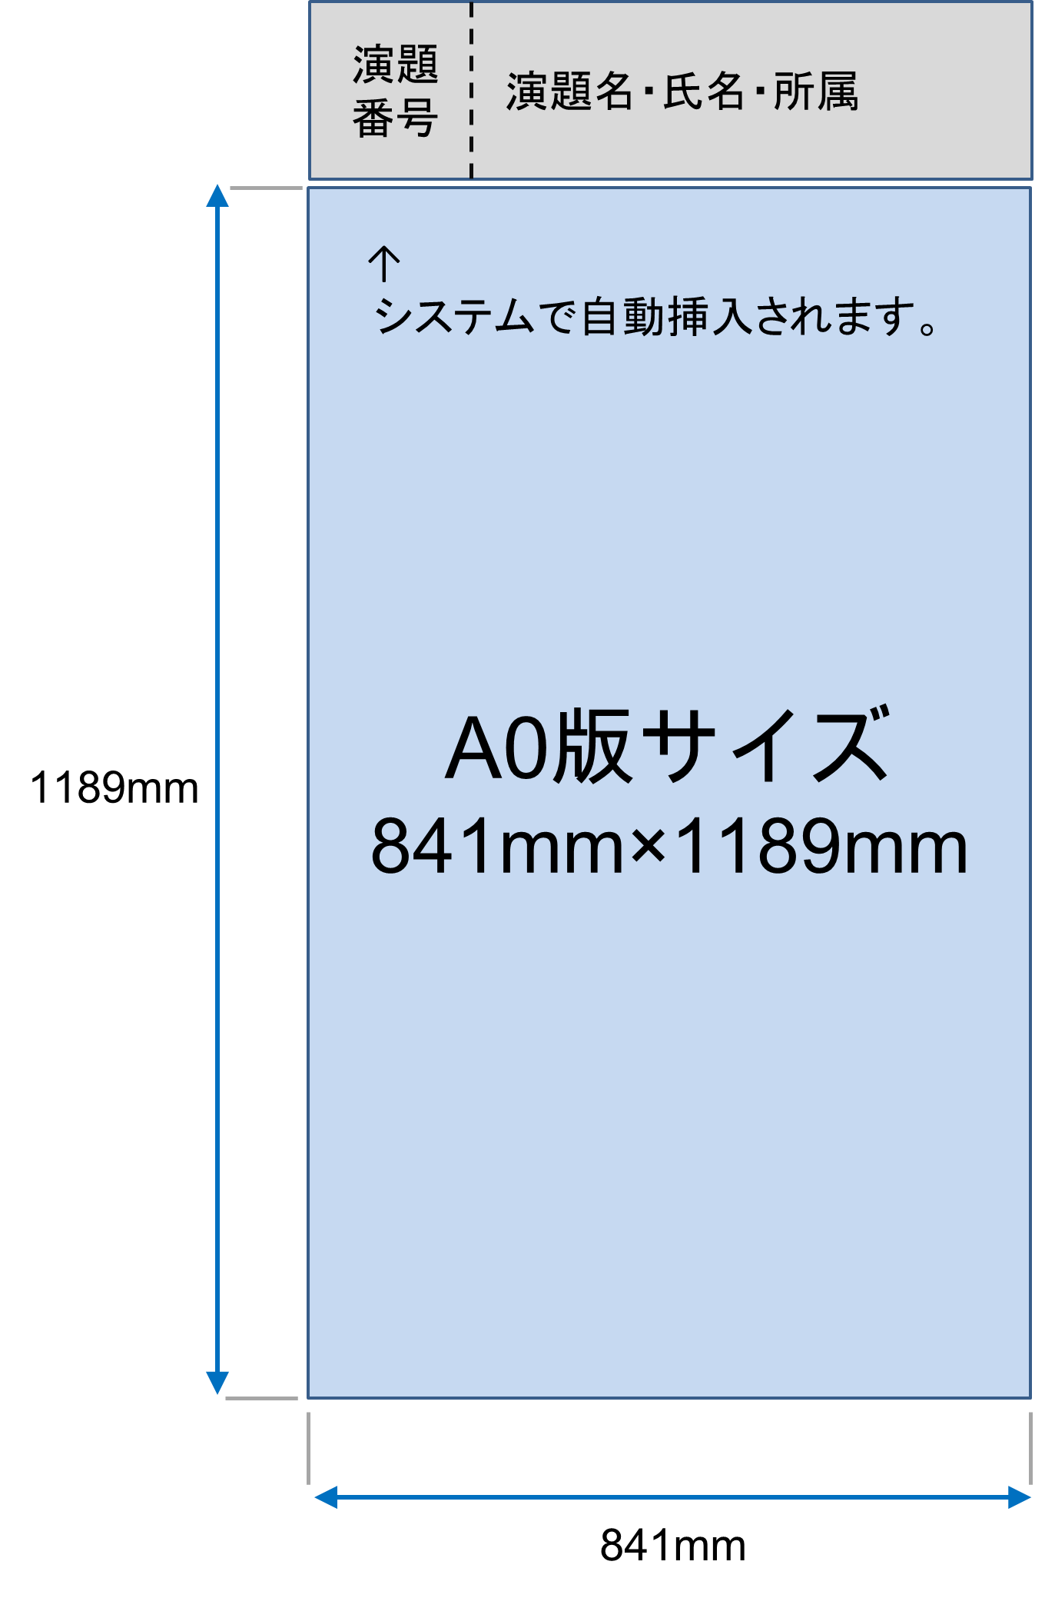


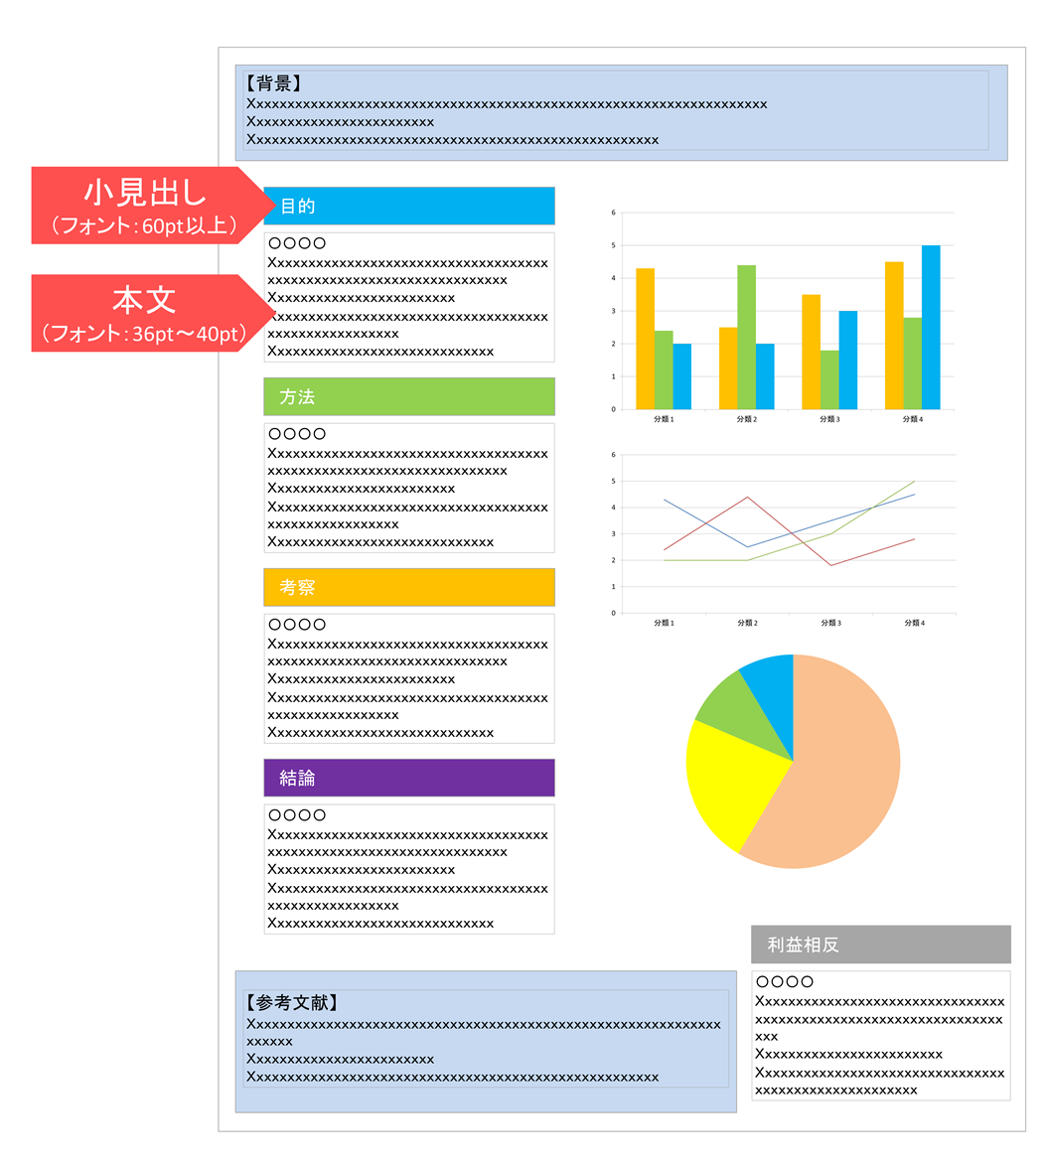














Only the first slide will be uploaded on the digital poster system
Title, author, co-author, affiliation will be automatically displayed on the digital poster viewer. Therefore, please do not contain them on your poster slide. ( The data entered for the abstract submission will be automatically displayed.)
The size of poster slide is A0 （841mm×1189mm）.
Please use the OS standard font such as below.
- Times New Roman, Arial, Arial Black, Arial Narrow, Century, Century Gothic, Courier, Courier New, Georgia
Conflicts of Interest
You are required to make a Conflict of Interest declaration.
Please fill out the COI form at the bottom right of Slide 1 of this PowerPoint file.
Layout Sample

