Slide 1
Please make your presentation on this slide.
（Please delete this text）
Presenting Author Conflict OF Interest Self－Declaration Form
 | Amount per year | Applicability | If applicable, company name, etc
(1) Position as an officer or advisor | 1,000,000 yen or more | Yes ／ no
(2) Ownership of stock | Profit of 1,000,000 yen or more /ownership of 5% or more of total shares | Yes ／ no
(3) Royalties or licensing fees | 1,000,000 yen or more | Yes ／ no
(4) Honoraria, etc | 500,000 yen or more | Yes ／ no
(5)Manuscript fees,etc | 500,000 yen or more | Yes ／ no
(6)Research funding | 1,000,000 yen or more | Yes ／ no
(7) Donations | 1,000,000 yen or more | Yes ／ no
(8) Other remuneration | 50,000 yen or more | Yes ／ no

Slide 2
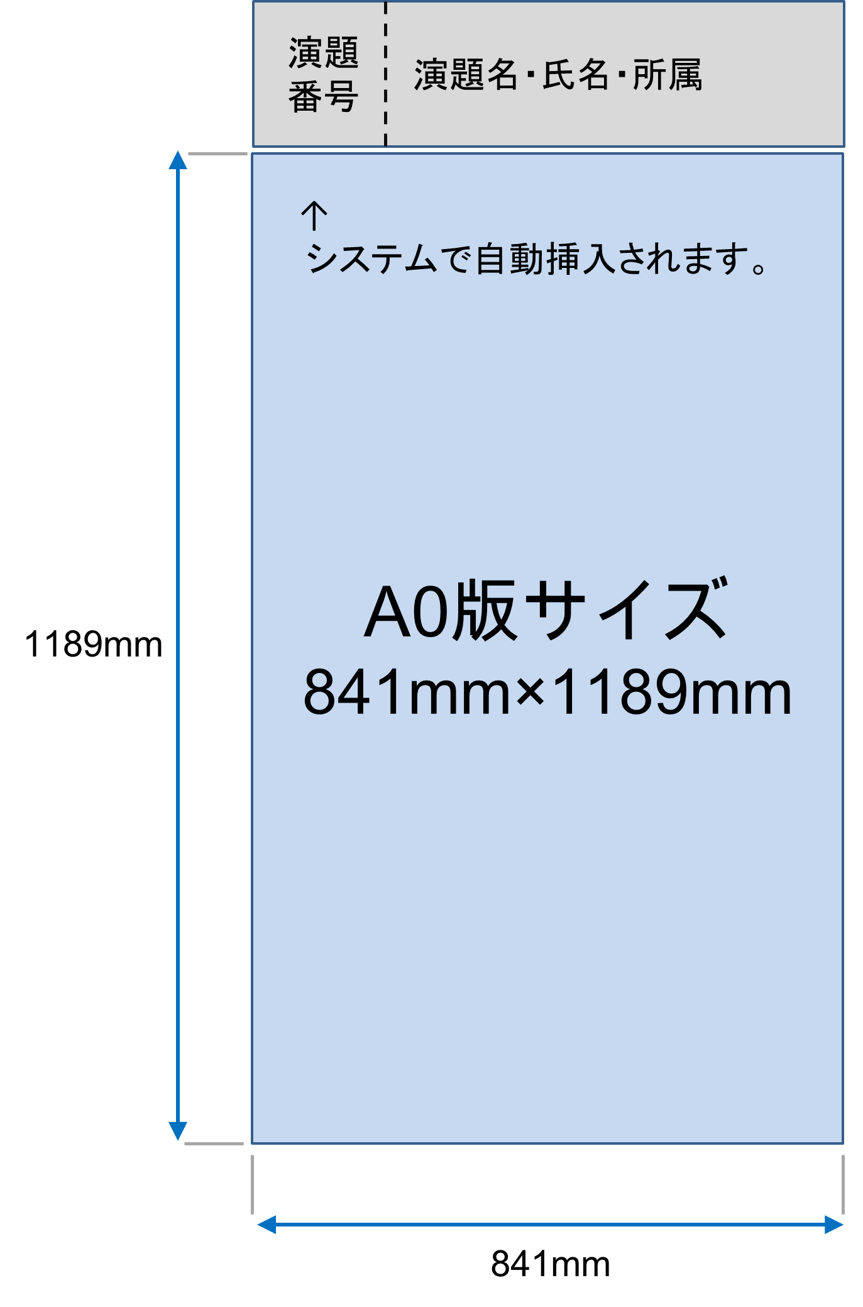
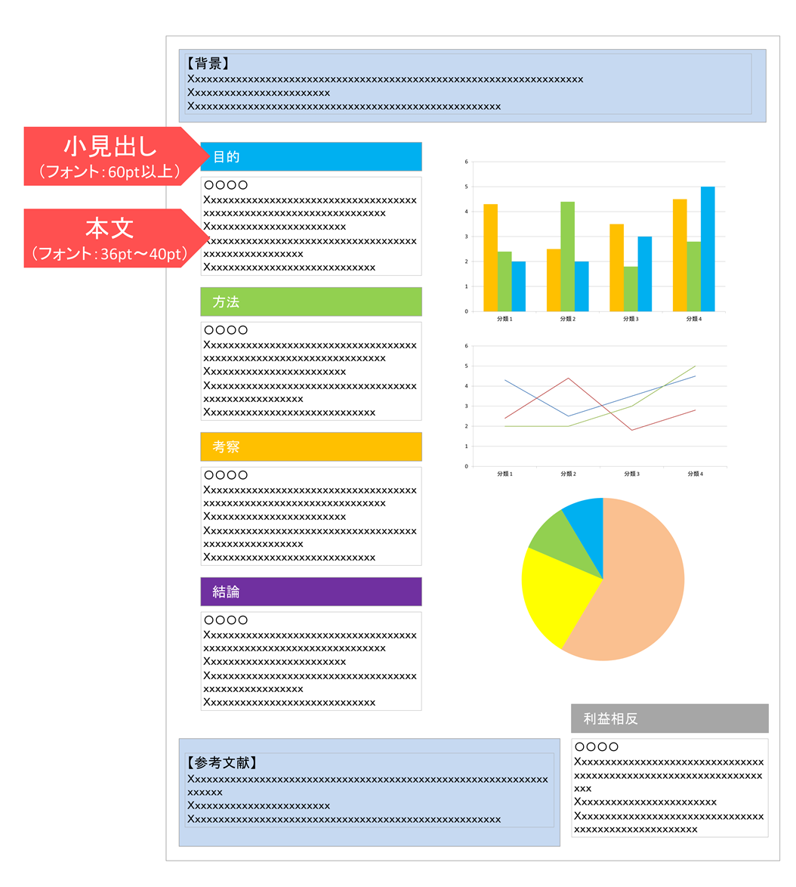
Only the first slide will be uploaded on the digital poster system
Title, author, co-author, affiliation will be automatically displayed on the digital poster viewer. Therefore, please do not contain them on your poster slide. ( The data entered for the abstract submission will be automatically displayed.)
The size of poster slide is A0 （841mm×1189mm）.
Please use the OS standard font such as below.
- Times New Roman, Arial, Arial Black, Arial Narrow, Century, Century Gothic, Courier, Courier New, Georgia
Conflicts of Interest
You are required to make a Conflict of Interest declaration.
Please fill out the COI form at the bottom right of Slide 1 of this PowerPoint file.
Layout Sample

